Slide 1
Musilarity
Web Analytics 2024
Amaia, Diego, Francisco, Alejandro

Slide 2
Project Idea
Music is deeply personal, yet universally shared.
A tool for SOCIAL CONNECTION
Take Spotify Wrapped one step further by adding a connection layer.

Slide 3
Project Goal
Similarity index by musical preferences

Slide 4
STATE OF THE ART

Slide 5



State of The Art
MUSILARITY
Ability to compare musical preferences between users.
Similarity index
Real time insights

Slide 6

DATA SOURCE

Slide 7
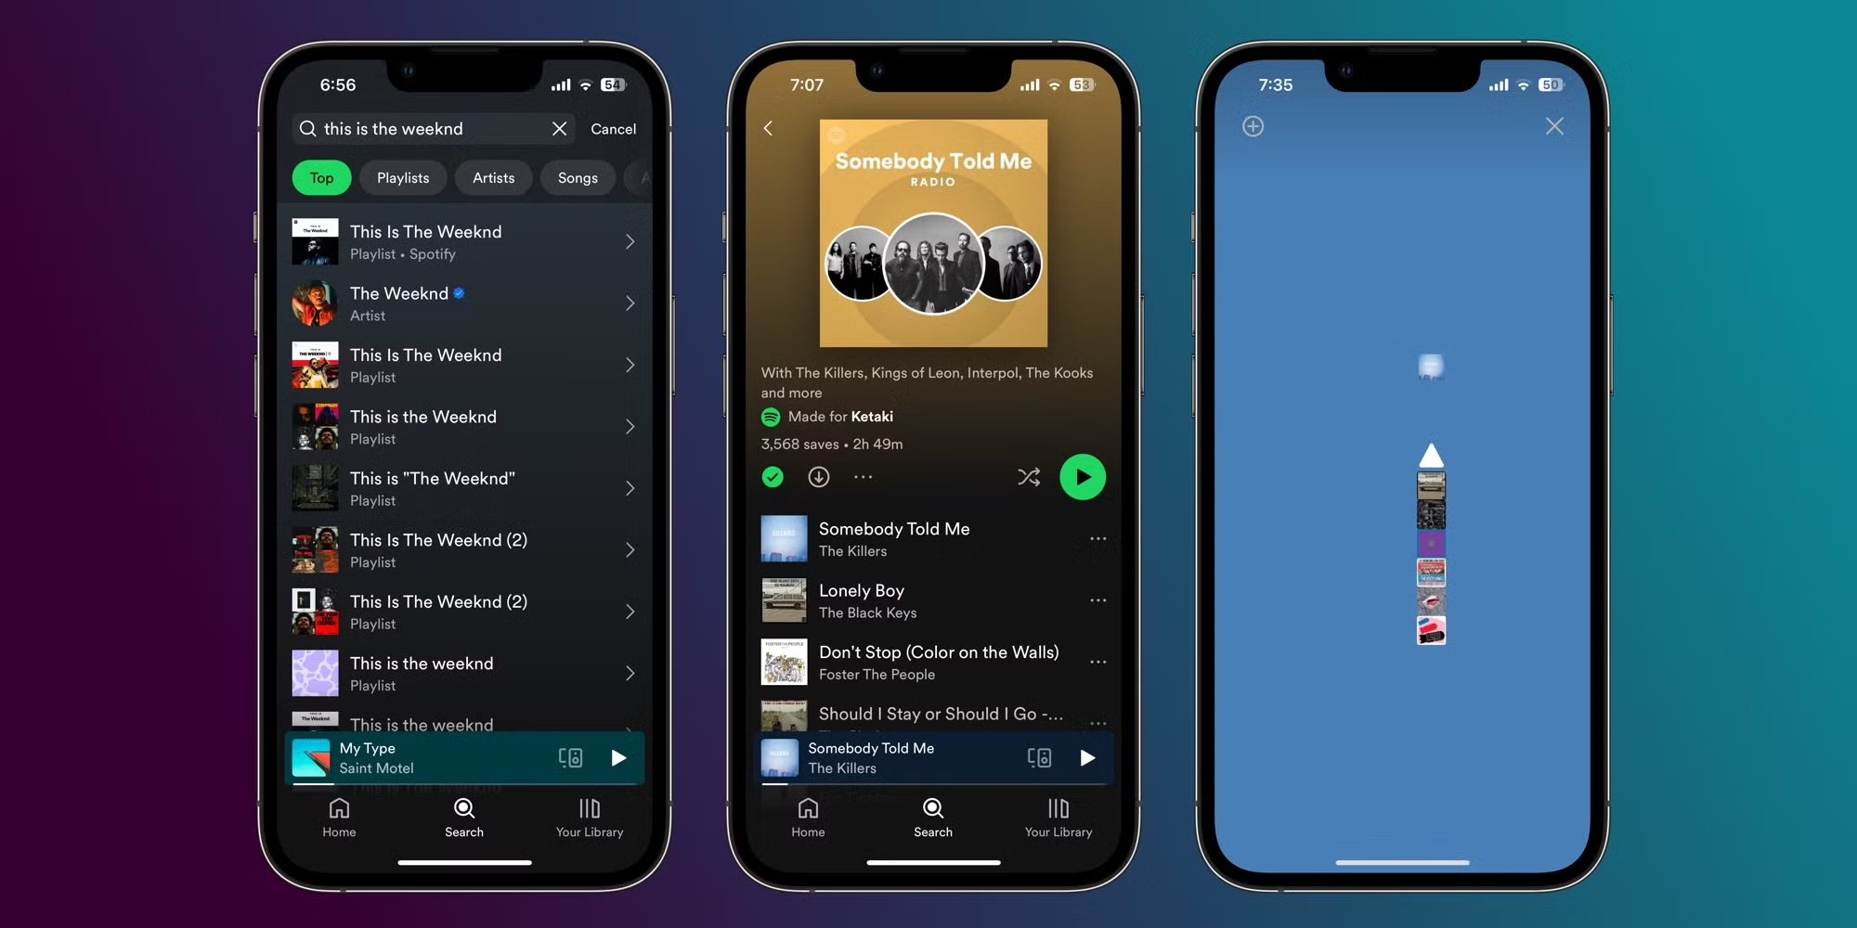



Spotify Web API

Slide 8

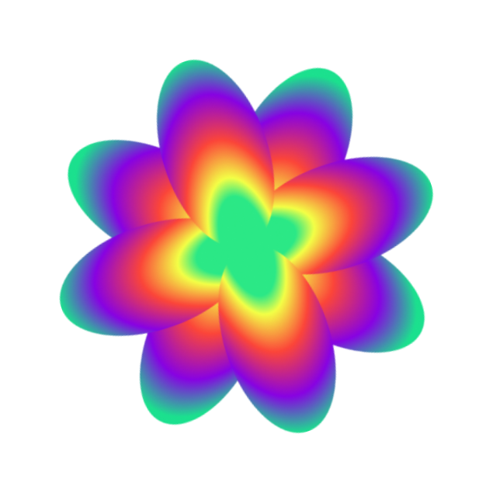
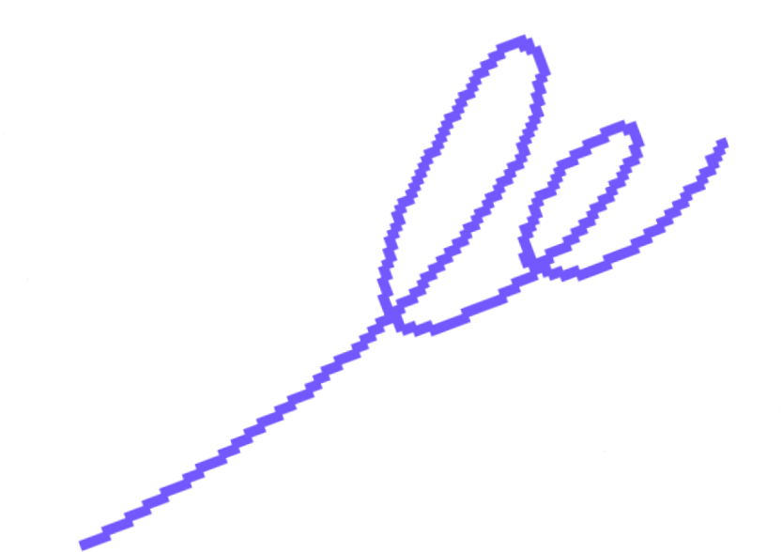



Spotify API allows access to detailed insights about users' listening habits
Data is retrieved directly from the user’s Spotify account
API ensures data is personalized
Provides data across three customizable time frames
Credit | Image: Unsplash

Slide 9
DATA GATHERING TECHNIQUE

Slide 10
Spotify APIints
Scope & authentication
Data retrieval
Custom filter

Slide 11






AUTHENTICATION SETUP
Registered on Spotify Developer Portal
Created the Spotify API (client ID & client Secret)
Implemented OAuth 2.0 Authorization Code Flow
Generated an access token after the user logged in

Slide 12
ENDPOINT SELECTION
Top Tracks Endpoint: user’s most listened tracks (long, mid and short)
Playlist Endpoint (used as fallback)
Artists Endpoint: gather information about artists associated genres

Slide 13
CUSTOM DATA FILTERING
Filter unique tracks and consolidate artist and genre information.
Randomized playlist tracks for diversity

Slide 14
GRAPH ANALYSIS

Slide 15
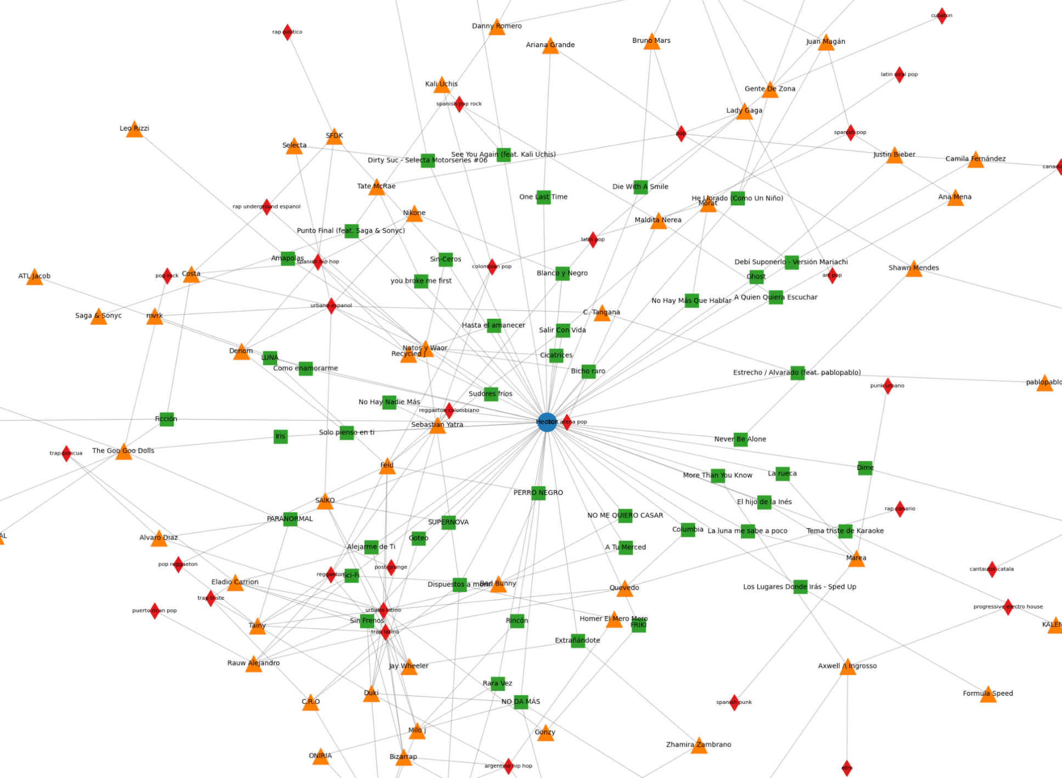
GRAPH CONSTRUCTION
USER
USER
TRACKS
TRACKS
ARTISTS
ARTISTS
GENRES
GENRES

Slide 16
Similarity Path Connections Approach
Pattern 2
Pattern 4
Pattern 6
TRACKS
ARTISTS
GENRES
USER
USER
TRACKS
TRACKS
ARTISTS
ARTISTS
USER
USER
TRACKS
TRACKS
All simple paths in a limited and controlled environment
Computational limitations
Does not detect all possible paths
Grows exponentially
USER
USER

Slide 17
SIMILARITY METRICS
Jaccard Similarity
Centrality Analysis
Variance Adjustment

Slide 18
Weighted Similarity Score Calculation:
Tracks: 10%
Artists: 20%
Genres: 70%
Adjusts scores based on variance in betweenness
Integrated Graph Analysis:
Merges individual user graphs to identify common nodes
Inverse Logarithm Similarity Score:
Higher and easier-to-understand values, more appealing to the user

Slide 19

DASHBOARD

Slide 20
CONCLUSION
Goal Achieved: We successfully created a similarity index.
One step further from individual statistics.

Slide 21
FUTURE
WORK

Slide 22
Future Work
Tracks
Index
Spotify wrap

